Slide 1
E-Medicare Application
Group 1-RLL-Project

Slide 2
Introduction
The goal of the E-Medicare System is to automate the current manual system with the use of computerized equipment and comprehensive computer software, meeting their criteria, in order to retain their important data and information for a longer period of time with simple access and manipulation.
As stated earlier, the e-Medicare System can result in an error-free, secure, dependable, and quick management system.

Slide 3
Development
The Application was developed in the span of 5 days, with the support of proper planning, implementation and teamwork.
The Application was developed in four phases: analysis, design, implementation, testing.
The Software project was developed using Agile Development model including daily sprints and frequent iterations.
The development model’s problem solving was inspired from a Divide & Conquer approach and adopts the agile methodology for planning and scheduling.

Slide 4
Planning Phase & Design Phase
Start time:21st Oct
End time : 22nd Oct
Consisting of the modularization of the whole problem statement into 8 different modules, split up among each team member.

Slide 5
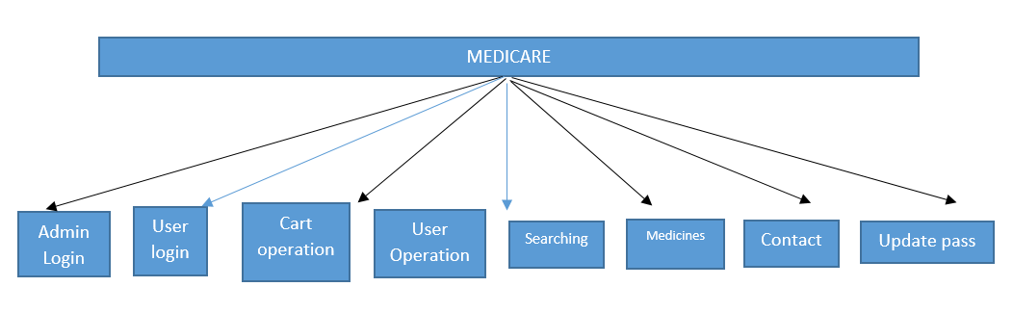
1.1 Modularization of the problem statement

Slide 6
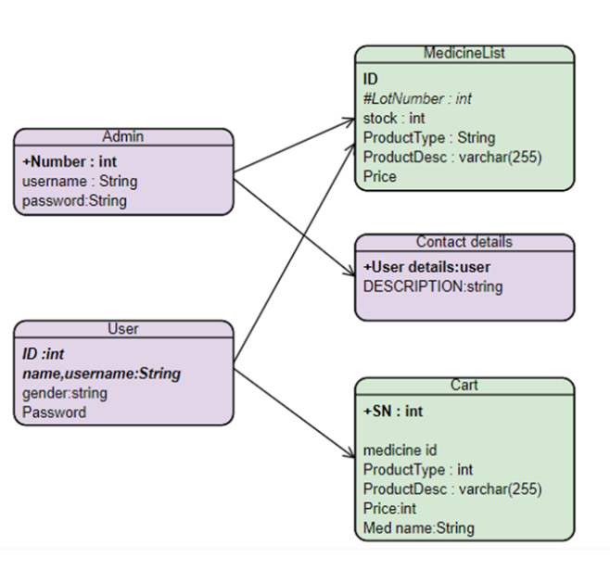
Class diagram
1.2 Class Diagram describing the DB design

Slide 7
Implementation phase & Testing phase
Start Time: 23rd Oct
End Time: 26th Oct
Completion of Front-End operations.
Challenges Faced: Searching and Change password

Slide 8
Technology Used
HTML : Page layout has been designed in HTML
CSS : CSS has been used for all the designing part
JavaScript : All the validation task and animations has been developed by Javascript
Java : All the business logic has been written in Java
MySQL : MySQL database has been used as database for the project
Angular CLI : Command-line interface tool that we use to initialize.

Slide 9
Modules of E-Medicare System
Admin Login: Managing admin Login credentials
User Login: Managing registration of user and Logging user in with the registered credentials
Cart Management: Managing and customizing whatever the user selects
Admin functions: Add, Delete and update a user/medicine in the DB
Search Filtering: Filtering the search according to the user’s choice.
Medicine Management: Display the medicine for the user
Feedback box: Updates the team on what is aspired by the user
Change Password: Change the password of user

Slide 10
Demo
Module wise demo

Slide 11
User Login & Admin Login
Back-End: Specifically defined functions for user login and admin login for Controller, Repository ,Entity and Service classes.
Front-End : Webpage creation for user and admin login
Handled by Rose Mary

Slide 12
User registration
Back-End: Specifically defined functions for user login for Controller, Repository ,Entity and Service classes.
Front-End : Webpage creation for user registration

Slide 13
Medicine CRUD
Back-End: Specifically defined functions for user login for Controller, Repository ,Entity and Service classes.

Slide 14
Functional Testing Phase results

Slide 15
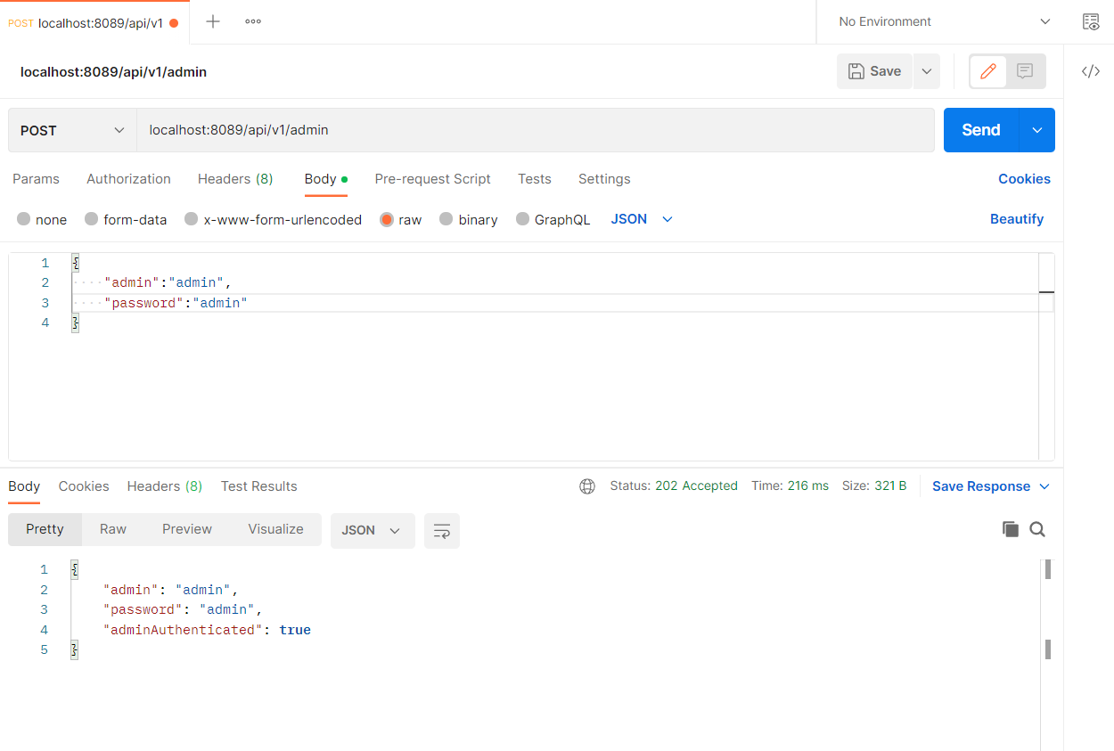

Slide 16
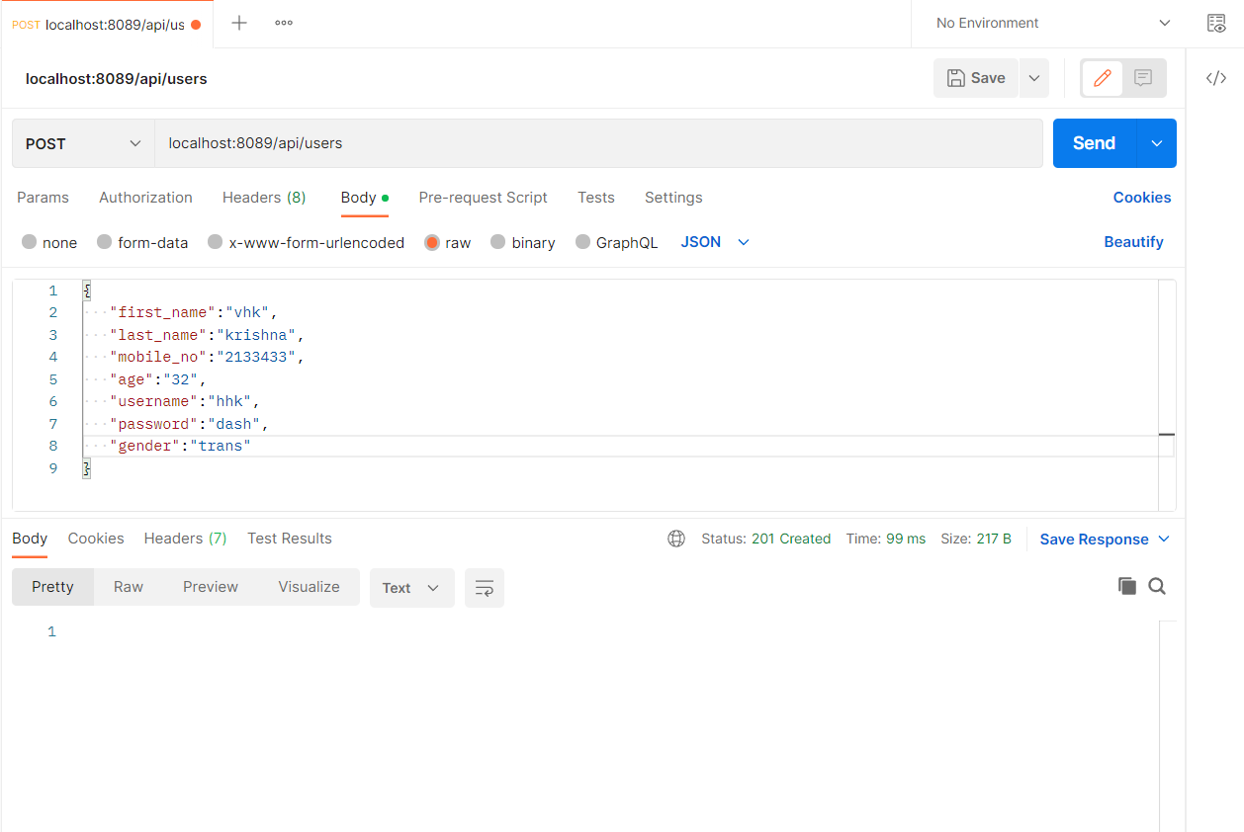
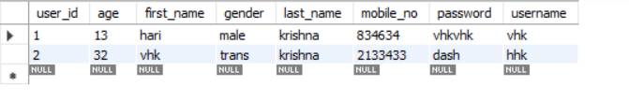

Slide 17
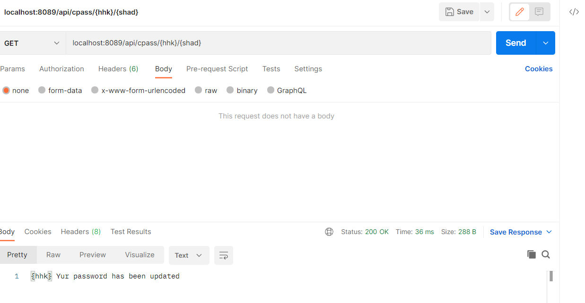

Slide 18
